Slide 1
Chương 1
Giới thiệu
ĐHBK Tp HCM - Khoa Đ-ĐT
BMĐT
Môn học: Xử lý tín hiệu số với FPGA
GVPT: Nguyễn Lý Thiên Trường
Email: truongnguyen@hcmut.edu.vn
203-B3

Slide 2
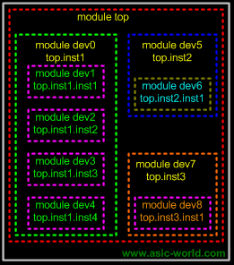
Hierarchical Design
Top Level
Module
Sub-Module
1
Sub-Module
2
Basic Module
1
Basic Module
2
Basic Module
3
E.g.
Full Adder
Half Adder
Half Adder

Slide 3


Module
module my_module(out1, .., inN);
output out1, .., outM;
input in1, .., inN;
.. // declarations
.. // description of f (maybe
.. // sequential)
endmodule
in1
my_module
out1
in2
out2
f
inN
outM
Everything you write in Verilog must be inside a module exception: compiler directives

Slide 4
Example: Half Adder
A
S
module half_adder(S, C, A, B);
output S, C;
input A, B;
wire S, C, A, B;
assign S = A ^ B;
assign C = A & B; //assign C = A && B;
endmodule
half
adder
B
C
A
S
B
C
&& → logical AND
|| → logical OR
! → logical NOT
& → bitwise AND
| → bitwise OR
~ → bitwise NOT
^ → bitwise XOR
~^ or ^~ → bitwise XNOR

Slide 5
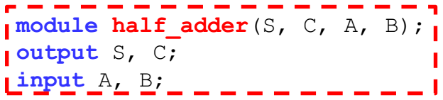
Example: Full Adder
in1
full_adder
A
S
I1
A
S
sum
half_adder
ha1
half_adder
ha2
in2
B
C
I2
B
C
I3
cout
cin
module full_adder(sum, cout, in1, in2, cin);
output sum, cout;
input in1, in2, cin;
wire sum, cout, in1, in2, cin;
wire I1, I2, I3;
half_adder ha1(I1, I2, in1, in2);
half_adder ha2(sum, I3, I1, cin);
assign cout = I2 || I3;
endmodule
Module
name
Instance
name
half_adder ha1(.S(I1), .C(I2), .A(in1), .B(in2));
half_adder ha2(.S(sum), .C(I3), .A(I1), .B(cin));

Slide 6
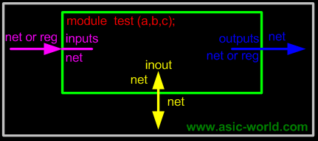
Port Assignments
module
Inputs
Outputs
Inouts
reg or net
net
External connection
Internal connection
http://www.asic-world.com/verilog/syntax2.html
module
Inputs : internally must always be of type net, externally the inputs can be connected to a variable of type reg or net.
Outputs : internally can be of type net or reg, externally the outputs must be connected to a variable of type net.
Inouts: internally or externally must always be type net, can only be connected to a variable net type.
reg or net
net
module
net
net

Slide 7
Dataflow Model (Continuous Assignements) a closer look
Syntax:
  assign #del <id> = <expr>;
Where to write them:
  inside a module
  outside procedures^{(*)}
Properties:
  they all execute in parallel
  are order independent
  are continuously active
optional
net type !!
^{(*)}Procedures = sections of code that we know they execute sequentially.

Slide 8
Structural Model (Gate Level)
Built-in gate primitives:
  and, nand, nor, or, xor, xnor, buf, not, bufif0, bufif1, notif0, notif1
Usage:
  nand (out, in1, in2); //2-input NAND without delay
  and #2 (out, in1, in2, in3); //3-input AND with 2 t.u. delay
  not #1 N1(out, in); //NOT with 1 t.u. delay and instance name
  xor X1(out, in1, in2); //2-input XOR with instance name
Write them inside module, outside procedures

Slide 9
Example: Half Adder,
2nd Implementation
half_adder
module half_adder(S, C, A, B);
output S, C;
input A, B;
wire S, C, A, B;
xor #2 (S, A, B);
and #1 (C, A, B);
endmodule
A
S
B
C
Assuming:
XOR: 2 t.u. delay
AND: 1 t.u. delay

Slide 10
Behavioral Model - Procedures (i)
Procedures = sections of code that we know they execute sequentially
Procedural statements = statements inside a procedure, they execute sequentially.
e.g. another 2-to-1 mux implementation:
  begin
  if (sel == 0)
  Y = B;
  else
  Y = A;
  end
Procedural assignments:
Y must be reg !!
Execution
Flow
A
1
Dataflow model
Y
assign Y = (sel)? A : B;
B
0
sel
Y must be wire !!

Slide 11
Behavioral Model - Procedures (ii)
Modules can contain any number of procedures
Procedures execute in parallel (in respect to each other) and ..
.. can be expressed in two types of blocks:
  initial → they execute only once
  always → they execute for ever (until simulation finishes)

Slide 12
“Initial” Blocks
Start execution at simulation time zero and finish when their last statement executes
Only used in test benches for simulation.
module nothing;
  initial
  $display(“I’m first”);
  initial
  begin
  #50;
  $display(“Really?”);
  end
  endmodule
Will be displayed
at sim time 0
Will be displayed
at sim time 50 t.u.
t.u. = time units

Slide 13
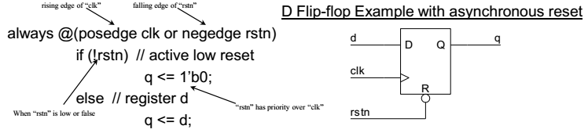
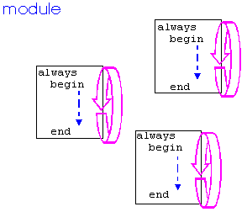
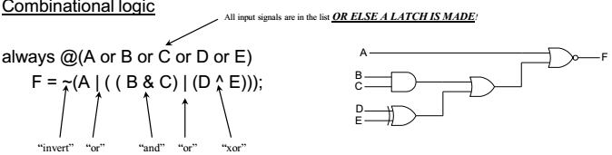
“Always” Blocks
A always block contains a trigger list of signals (variables) which will cause the block to be executed whenever a signal changes it’s value.
Start execution at simulation time zero and continue until simulation finishes.
Multiple always block operate in parallel, not in sequence or order.

Slide 14
Events (i)
@
  always @(signal1 or signal2 or ..)
  begin
  ..
  end
  always @(posedge clk)
  begin
  ..
  end
  always @(negedge clk)
  begin
  ..
  end
execution triggers every
time any signal changes
execution triggers every
time clk changes
from 0 to 1
execution triggers every
time clk changes
from 1 to 0

Slide 15
Examples
3rd half adder implem.
  module half_adder(S, C, A, B);
  output S, C;
  input A, B;
  reg S,C;
  wire A, B;
  always @(A or B)
  begin
  S = A ^ B;
  C = A && B;
  end
  endmodule
Behavioral edge-triggered DFF implementation
  module dff(Q, D, Clk);
  output Q;
  input D, Clk;
  reg Q;
  wire D, Clk;
  always @(posedge Clk)
  Q = D;
  endmodule

Slide 16
Examples
always @(res or posedge clk) begin
if (res) begin
Y = 0;
W = 0;
end
else begin
Y = a & b;
W = ~c;
end
end
res
a
b
Y
c
W
clk

Slide 17
Events (ii)
wait (expr)
always begin
  wait (ctrl)
  #10 cnt = cnt + 1;
  #10 cnt2 = cnt2 + 2;
  end
e.g. Level triggered DFF ?
Not synthesizable only used for testbench.
execution loops every
time ctrl = 1 (level
sensitive timing control)

Slide 18
Timing (i)
don’t care (x)
d
initial begin
#5 c = 1;
#5 b = 0;
#5 d = c;
end
c
b
0
5
10
15
Time
Each assignment is
blocked by its previous one

Slide 19
Timing (ii)
d
initial begin
fork
#5 c = 1;
#5 b = 0;
#5 d = c;
join
end
c
b
0
5
10
15
Time
Assignments are
not blocked here

Slide 20
Procedural Statements: if
E.g. 4-to-1 mux:
module mux4_1(out, in, sel);
output out;
input [3:0] in;
input [1:0] sel;
reg out;
wire [3:0] in;
wire [1:0] sel;
always @(in or sel)
if (sel == 0) //2’b00
out = in[0];
else if (sel == 1) //2’b01
out = in[1];
else if (sel == 2) //2’b10
out = in[2];
else //2’b11
out = in[3];
endmodule
if (expr1)
true_stmt1;
else if (expr2)
true_stmt2;
..
else
def_stmt;
in[3]
in[2]
11
in[1]
10
out
in[0]
01
00
2
sel
Used for synthesizable code

Slide 21
Procedural Statements: case
E.g. 4-to-1 mux:
module mux4_1(out, in, sel);
output out;
input [3:0] in;
input [1:0] sel;
reg out;
wire [3:0] in;
wire [1:0] sel;
always @(in or sel)
case (sel)
0: out = in[0];
1: out = in[1];
2: out = in[2];
3: out = in[3];
endcase
endmodule
case (expr)
item_1, .., item_n: stmt1;
item_n+1, .., item_m: stmt2;
..
default: def_stmt;
endcase
in[3]
in[2]
11
in[1]
10
out
in[0]
01
00
2
sel
Used for synthesizable code

Slide 22
Procedural Statements: for
for (init_assignment; cond; step_assignment)
stmt;
E.g.
module count(Y, start);
output [3:0] Y;
input start;
reg [3:0] Y;
wire start;
integer i;
initial
Y = 0;
always @(posedge start)
//execute code while i < 3
for (i = 0; i < 3; i = i + 1)
#10 Y = Y + 1;
endmodule
Can be used for synthesizable code but has generally been difficult to use.

Slide 23
Procedural Statements: while
Executes code as long as the specified condition is true.
Not synthesizable.
E.g.
module count(Y, start);
output [3:0] Y;
input start;
reg [3:0] Y;
wire start;
integer i;
initial
Y = 0;
always @(posedge start) begin
i = 0;
while (i < 3) begin
#10 Y = Y + 1;
i = i + 1;
end
end
endmodule
while (expr) stmt;

Slide 24
Procedural Statements: repeat
Executes the following statement a fixed number of times.
Only used for test benches.
Not synthesizable.
E.g.
module count(Y, start);
output [3:0] Y;
input start;
reg [3:0] Y;
wire start;
initial
Y = 0;
always @(posedge start)
repeat (4) #10 Y = Y + 1;
endmodule
repeat (times) stmt;
Can be either an
integer or a variable

Slide 25
Procedural Statements: forever
Repeats a statement indefinitely until simulator stops.
Only used for test benches, excellent for implementing clocks and repeating sequences.
Not synthesizable.
Typical example:
clock generation in test modules
module test;
reg clk;
initial begin
clk = 0;
forever #10 clk = ~clk;
end
other_module1 o1(clk, ..);
other_module2 o2(.., clk, ..);
endmodule
T_{clk} = 20 time units
forever stmt;
Executes until sim
finishes

Slide 26
Mixed Model
Code that contains various both structure and behavioral styles
module simple(Y, c, clk, res);
output Y;
input c, clk, res;
reg Y;
wire c, clk, res;
wire n;
not(n, c); // gate-level
always @(res or posedge clk)
if (res)
Y = 0;
else
Y = n;
endmodule
simple
res
c
n
Y
clk

Slide 27
Parameters (i)
in[3:0]
p_in[3:0]
out[1:0]
wu
Implelementation
without parameters
wd
clk
module dff4bit(Q, D, clk);
output [3:0] Q;
input [3:0] D;
input clk;
reg [3:0] Q;
wire [3:0] D;
wire clk;
always @(posedge clk)
Q = D;
endmodule
module dff2bit(Q, D, clk);
output [1:0] Q;
input [1:0] D;
input clk;
reg [1:0] Q;
wire [1:0] D;
wire clk;
always @(posedge clk)
Q = D;
endmodule

Slide 28
Parameters (ii)
module top(out, in, clk);
output [1:0] out;
input [3:0] in;
input clk;
wire [1:0] out;
wire [3:0] in;
wire clk;
wire [3:0] p_in; // internal nets
wire wu, wd;
assign wu = p_in[3] & p_in[2];
assign wd = p_in[1] & p_in[0];
dff4bit instA(p_in, in, clk);
dff2bit instB(out, {wu, wd}, clk);
// notice the concatenation!!
endmodule
Implelementation
without parameters (cont.)
in[3:0]
p_in[3:0]
out[1:0]
wu
wd
clk
dff4bit(Q, D, clk)
dff2bit(Q, D, clk)

Slide 29
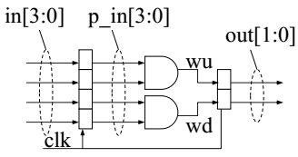
Parameters (iii)
Implelementation
with parameters
module top(out, in, clk);
output [1:0] out;
input [3:0] in;
input clk;
wire [1:0] out;
wire [3:0] in;
wire clk;
wire [3:0] p_in;
wire wu, wd;
assign wu = p_in[3] & p_in[2];
assign wd = p_in[1] & p_in[0];
dff instA(p_in, in, clk);
// WIDTH = 4, from declaration
dff instB(out, {wu, wd}, clk);
defparam instB.WIDTH = 2;
// We changed WIDTH for instB only
endmodule
module dff(Q, D, clk);
parameter WIDTH = 4;
output [WIDTH-1:0] Q;
input [WIDTH-1:0] D;
input clk;
reg [WIDTH-1:0] Q;
wire [WIDTH-1:0] D;
wire clk;
always @(posedge clk)
Q = D;
endmodule

